Slide 3
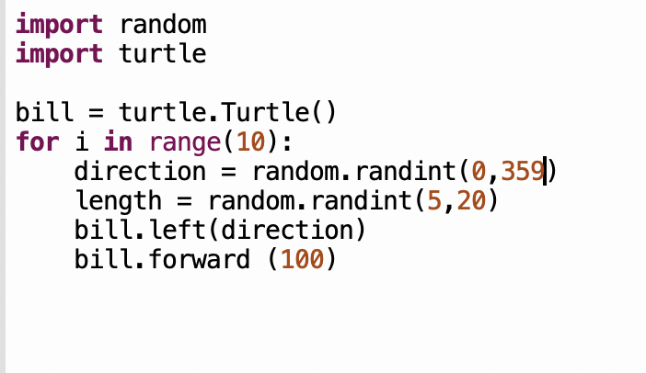

Slide 7
# 50 of the character
# 10 rows
character = input("Input a Character to print. ")
for i in range(10):
for i in range(50):
print(character, end ="")
print()

Slide 9
import random
import turtle
bob = turtle.Turtle()
for x in range(10):
bob.left(random.randint(0,360))
bob.forward(random.randint(0,36))

Slide 11
import turtle
import random
tex = turtle.Turtle()
for i in range(10):
tex.right(random.randint(0,360))
tex.forward(random.randint(5,21))

Slide 12
Room 12
def rectangle(char):
for x in range(10):
for y in range(50):
print(char,end="")
print("")
rectangle("c")

Slide 13
Room 18
USE_SYBOL = input("give me a symbol: ")
def rec_angel(symbol):
for n in range(10):
for i in range(50):
print(symbol, end="")
print(“”)
if __name__ == "__main__":
rec_angel(USE_SYBOL)
import turtle
import random
bob = turtle.Turtle()
for i in range(10):
bob.right(random.randint(0,358)
bob.forward(random.randint(5,30)

Slide 14
Room 25
import turtle
import random
john = turtle.Turtle()
for x in range(10):
john.left(random.randint(0,360))
john.forward(random.randint(5,20))
def printBlock(character):
output = ""
for y in range(10):
for x in range(50):
output += character
output = output + "\n"
return output
char = input("enter the character\n>")
print(printBlock(char))

Slide 16
Room 16
Import turtle
tex = turtle.Turtle()
for i in range(10):
random_move = random.randint(4,20)
random_turn = random.randint(0,359)
tex.forward(random_move)
tex.left(random_turn)

